Slide 1
Acids and Bases

Slide 2
Acids
Taste Sour
Are electrolytes which means acids conduct electricity when dissolved in water
React with metals to produce H₂ and with carbonates to produce CO₂
Turn litmus paper red
Have a pH less than 7
Have Formulas that usually begins with an “H”

Slide 3
Definitions of Acids
Acids release H⁺ ions when mixed with water. The hydrogen in the formula must be an acidic hydrogen which means it can be released (disassociate) as a H⁺. (Arrhenius Definition)
An Acid will donate H⁺ ions (protons). (Brønsted-Lowry Definition)
Accept electron pairs (Lewis Definition)

Slide 4
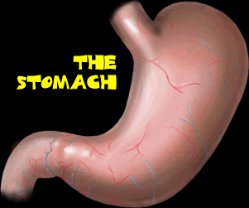
Digestion

Slide 5
Acids can be used as an Electrolyte
Acids are important for production of some polymers

Slide 6
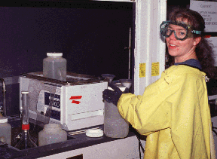
Cleaning
Metals – Pickling
Masonary - Etching

Slide 7
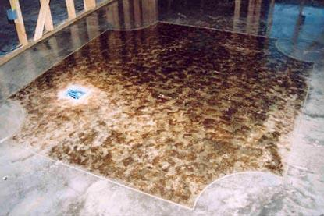
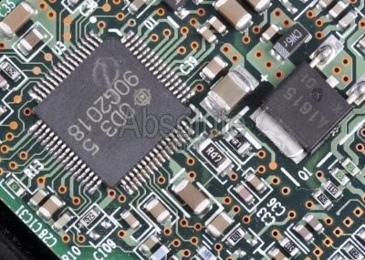
Artwork and Engineering

Slide 8
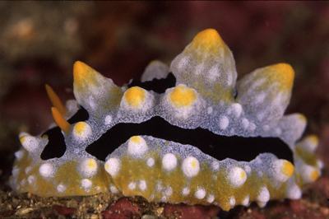
Protection
Sea Slugs use H₂SO₄
Ants in Tasmania use formic acid ☺

Slide 9
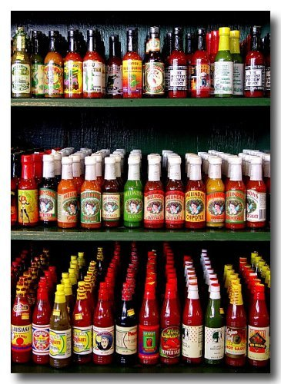
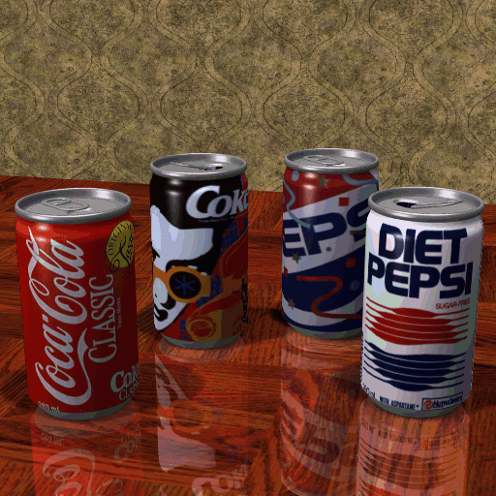
Flavoring and preserving food and drink
Test common foods with pH paper

Slide 10
Citric Acid
H₃C₆H₅O₇

Slide 11
Are all acids equally dangerous?
How dangerous an acid is depends on the acid’s
Strength which is measured by the ease with which the acid disassociates / releases H⁺
Concentration of the acid which is a measure of the amount of acid per volume

Slide 12
Bases
Taste Bitter
Feel slippery Ex: Soap
Will conduct electricity when dissolved in water
Turn litmus paper blue
Have a pH greater than 7

Slide 13
Definitions of Bases
Bases release OH⁻ ions when mixed with water. The “OH” must be able to disassociate from the rest of the molecule (Arrhenius Definition)
A Base will accept H⁺ ions (protons).
(Brønsted-Lowry Definition)
Donate a lone pair of electrons (Lewis Definition)

Slide 14
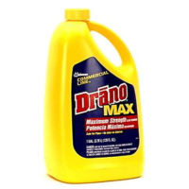
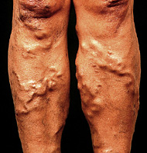
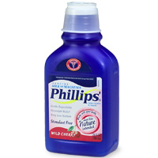
Uses of Bases

Slide 15
Ammonium hydroxide called “Ammonia” is also used as a cleaning agent.
Sodium hydroxide known as lye is used in the manufacture of soap, rayon, and paper.
Calcium hydroxide, commonly known as lime, is used in the preparation of plaster and mortar.

Slide 16
Are bases dangerous?
Bases can be dangerous as well, but it again depends on…..
Strength which is measured by the ease with which the base disassociates to release OH⁻ or accepts H⁺
Concentration of the base which is a measure of the amount of base per volume

Slide 17
Identifying Acids / Bases from a Chemical Formula
Acids
Will have a hydrogen (the formula will usually start with hydrogen except Carboxylic Acids)
Ionic-like -Look for a hydrogen with a halogen or polyatomic ion
Bases
Metal Hydroxide or have an Amine Group

Slide 18
Are any of these Acids or Bases?
H₂
CH₄
HBr
KOH
CH₃OH
HC₂H₃O₂
N₂
Ca(OH)₂

Slide 19
Acid’s Name from Anion Part of Acid
-ide
Like HF
Hydro______ ic Acid
Hydrofluoric Acid
-ate
Like HNO₃
_____________ic Acid
Nitric Acid
-ite
Like HNO₂
_____ous acid
Nitrous Acid

Slide 20
Base Nomenclature No Special Naming for Metal Hydroxides

Slide 21
Additional Categories of Acids and Bases

Slide 22
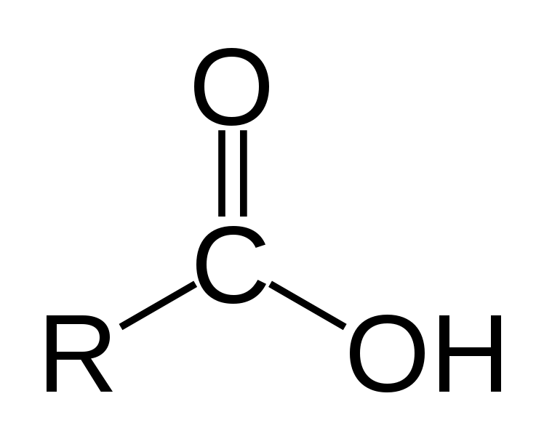
Carboxylic Acids have an -COOH Group

Slide 23
Amines (R-NH₂) are Bases

Slide 24
CARBOXYLIC ACID
AMINE BASE

Slide 25
AMINO ACIDS

Slide 26
How can an Amine (-NH₂) be classified as a Base? I have heard that water is sometime thought of as an acid and sometimes as a base? How is that possible?

Slide 27
Acid-Base Reactions

Slide 28
Neutralization Rxns - Acid & Metal Hydroxide
HF + KOH →
H₂S + Ca(OH)₂ →
H₂CO₃ + LiOH →
H₃PO₄ + Ba(OH)₂ →
Al(OH)₃ + HNO₃ →
NaOH + H₂CrO₄ →

Slide 29
Products are always salt and water
HF + KOH → KF + H(OH)
H₂S + Ca(OH)₂ → CaS + 2 H(OH)
H₂CO₃ + 2LiOH → Li₂(CO₃) + 2 H(OH)
2H₃PO₄ + 3Ba(OH)₂ → Ba₃(PO₄)₂ + 6 H(OH)
Al(OH)₃ + 3HNO₃ → Al(NO₃)₃ + 3 H(OH)
2NaOH + H₂CrO₄ → Na₂CrO₄ + 2 H(OH)

Slide 30
Other Neutralization Reactions

Slide 31
Condensation Reaction
+ H₂O

Slide 32
Kevlar

Slide 34
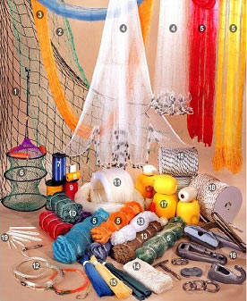
Demo – Making Nylon

Slide 35
Neutralization of Acid with Carbonate
Products are Salt, Water & Carbon Dioxide
_____H₃PO₄ + ____K₂CO₃ →
_____ CaCO₃ + _____ HCl →
_____ Na₂CO₃ + _____ HCl →
_____ H₂SO₄ + _____ NaHCO₃ →

Slide 36
Reactions of Acids with Metals
Zn + HBr →
Fe + H₂SO₄ → Use Fe³⁺ as ion
Cu + HCl → Use Cu²⁺ as ion

Slide 37
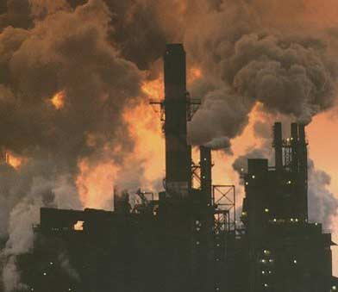
Acid Pollution

Slide 38
ACID RAIN AND ITS PREVENTION

Slide 39
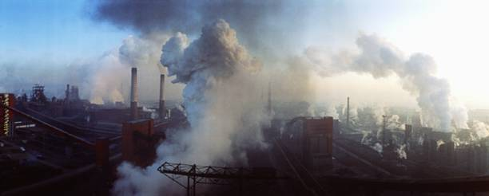
Fossil Fuels Contain Sulfur and Air Contains Nitrogen: Burning Fossil Fuels creates NO_{x} and SO_{x}

Slide 41
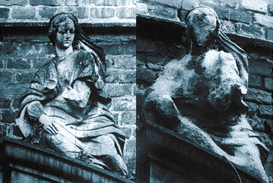
Damage Caused by NO_{x} & SO_{x}

Slide 42
How acid rain is produced in the atmosphere SO₂ + H₂O → H₂SO₃ SO₃ + H₂O → H₂SO₄ 2NO₂ + H₂O → HNO₃ +HNO₂

Slide 43
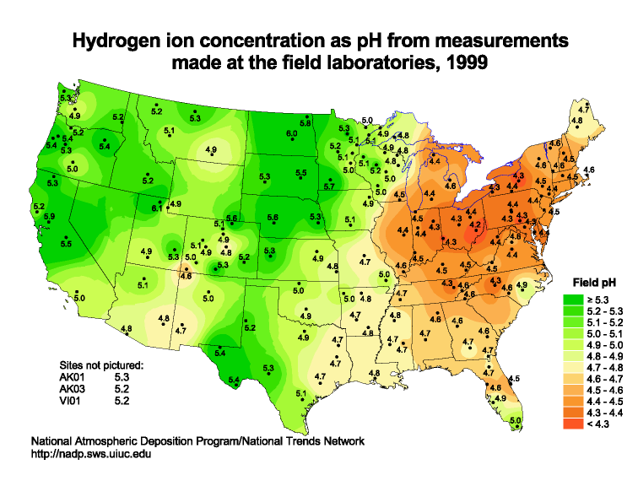

Slide 45
WS – Acid Rain What are the negative impacts of acid rain?
Weakens or Kills Vegetation by adjusting the soil or waters pH and preventing the absorption of nutrients. This can happen both on land and in water.
Lack of food kills animal life
Corrodes metals & carbonates (limestone & marble)
Reduces visibility (Smog)
Increases incidents of asthma and respiratory illnesses

Slide 46
Why do lakes with limestone bottoms or limestone (CaCO₃) sides resist acid rain better than Granite (SiO₂) or other stones?

Slide 47
Lab – Acid Rain

Slide 48
Demo – Making Smog

Slide 49
How do you reduce Smog?
Fume Scrubbing
Demo and Presentation

Slide 50
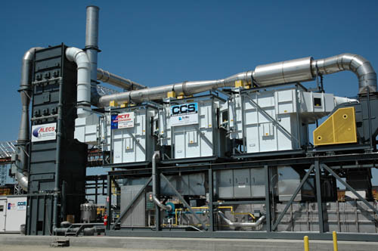
Fume Scrubbing

Slide 51
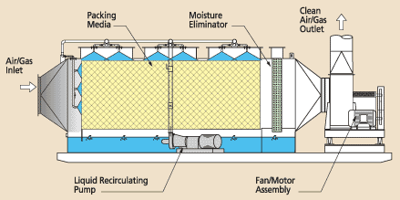
Horizontal Packed Bed

Slide 52
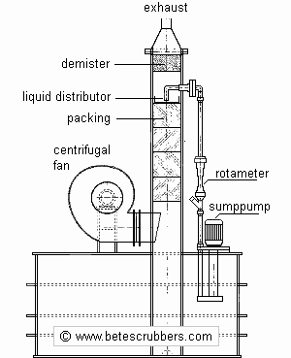

Slide 53
DEMONSTRATION 2NO₂ + H₂O → HNO₃ + HNO₂ HNO₃ + NaOH →NaNO₂ + H₂O HNO₂+ NaOH → NaNO₃ + H₂O

Slide 54
Lab – Titration & Reclamation of an Acidic Pond

Slide 55
Let’s Assume that we have a pond that has been damaged by acid rain. We would like to remediate the situation (fix the pond) how do we do it?

Slide 56
Today You’re an Environmental Engineer
Your job is to remediate a pond that has been damaged by acid rain.
How will you do it?

Slide 57
The acid in the pond water will need to be neutralized with a base. Before you can perform the neutralization the amount of acid to be neutralized will need to be known.

Slide 58
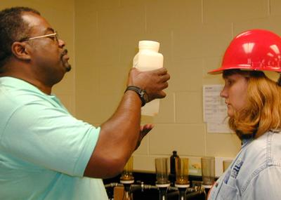
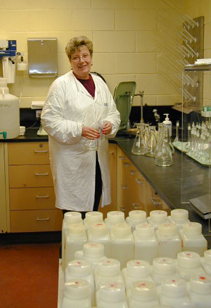
To determine the concentration of acid in the pond we will do a TITRATION

Slide 59
In chemistry, concentration is the measure of how much of a given substance there is mixed with another substance.

Slide 60
Concentrations can be measured as a MOLARITY
Molarity is moles per liter of solution
M_{x} = moles X / liter of solution

Slide 61
Test Understanding of Molarity
What is the molarity of a solution that has 2.5 moles of HNO₃ in 5.0 liter aqueous solution?
What is the molarity of a solution that has 4.0 moles of NaOH in 10.0 L aqueous solution?
What is the molarity of a solution that has 25.0 grams of NaOH in 2.0 L aqueous solution?
How many moles of HCl should be added to 5.0 L of solution to make it a 2.0 M aqueous solution?

Slide 62
Titration is a experimental technique for finding concentration

Slide 63
Basics of titration
Measure out a volume of the unknown solution
Neutralize the unknown solution with an standard solution of acid or base. The concentration of the standard solution is known.
Use the following formula (M_{A}V_{A} = M_{B}V_{B}) to find the concentration of the acid or base.

Slide 64
If we wanted to find the concentration of a HCl solution we could add NaOH to the solution until the acid was neutralized (pH = 7). The rxn is HCl + NaOH → NaCl + H₂O At pH = 7 the amount of acid is equal to the amount of base added.

Slide 65
M_{acid}V_{acid} = M_{base}V_{base}
Titration is the measurement of concentration through neutralization

Slide 66
If we know the amount of acid in the small sample, using a proportion we can scale-up to the amount of acid in the pond.
Moles in Sample = Moles in Lake
Liters of Sample Liters of Lake

Slide 67
Picking Indicators Solutions for a Titration
Indicator | pH Range for Color Change | Lower pH color | Higher pH color
Methyl Orange | 3.1 – 4.4 | Red | Yellow
Bromthymol Blue | 6.0 – 7.6 | Yellow | Blue
Litmus | 4.5 – 8.3 | Red | Blue
Phenolphthalein | 8.3 –10.0 | Colorless | Red

Slide 68
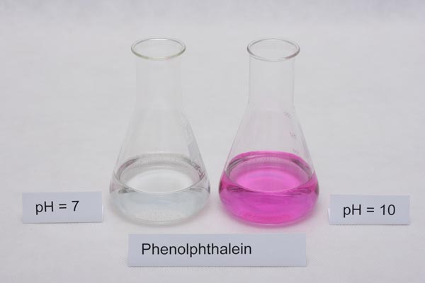
Phenolphthalein is a good indicator to use because it has a colorless phase.

Slide 69
How can you tell the concentration when the indicator has a range of pH?

Slide 70
STRONG ACID AND BASE

Slide 73
Lab – Titration of Acidic Lake Water

Slide 74
There are two important and different properties of acids and bases that determine the ability of and extent to which an acid or base can react. STRENGTH (ability) and CONCENTRATION (extent)

Slide 75
Concentration is obvious. More acid per volume means more chemical to react. The same is true for bases.

Slide 76
Concentration does not tell the whole story, we also need strength.

Slide 77
Acids do not all have the “action” or ability to react. The same is true for Bases. Some split more readily than others. Some Acids have more H⁺ and some Bases have more OH⁻s.

Slide 78
OCEAN ACIDIFICATION
CO₂ + H₂O → H⁺ + HCO₃⁻
H⁺ + CO₃²⁻ → 2HCO₃⁻

Slide 79
Ocean Acidification
The Acid Test Video
WS – Ocean Acidification
Activity – Creating acidic water (Tap H₂O and Bromothymol Blue)

Slide 80
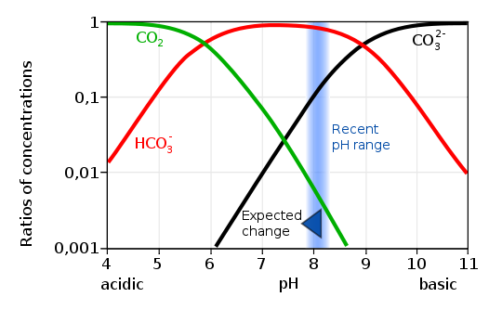

Slide 81
Effects of Ocean Acidification?
LOSS OF HABITAT

Slide 82
LOSS OF PART OF FOOD CHAIN

Slide 83
END

Slide 84
Lewis Acids and Bases
Lewis Theory Defines Acids as electron pair acceptors and Bases as electron pair donors. An acid may destroy a bond to take the electron pair and a base creates a bond by donating a pair.
Consider the reaction of HCl with NH₃
Note the conjugate acids and bases

