Slide 1
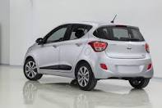
Hyundai Hybrid Model Car
By: Gabriella Bitton, Ronan Shaffer, Samantha Boyd

Slide 2
The Objective
To alternatively power a car that runs precisely five meters.
The vehicle must be able to carry 100 pennies (250 grams) using a fuel source other than gasoline, or oil.

Slide 3
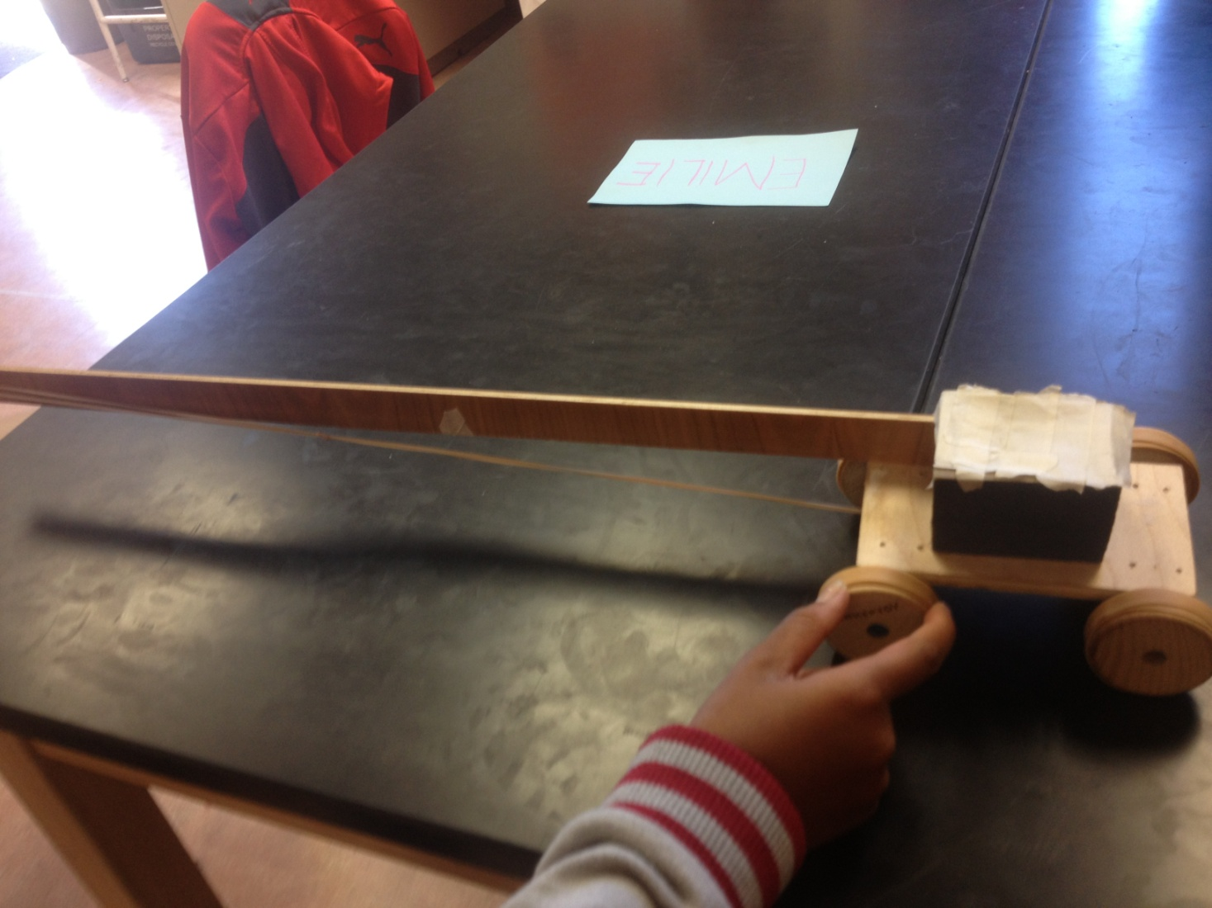
The Car:

Slide 4
How It Is Powered
Our car is powered by rubber bands.
We tightly wind the rubber bands around the axle which creates potential energy.
As the rubber bands unravel they cause the axle to rotate therefore, causing the wheels to turn and propelling the car forward.

Slide 5
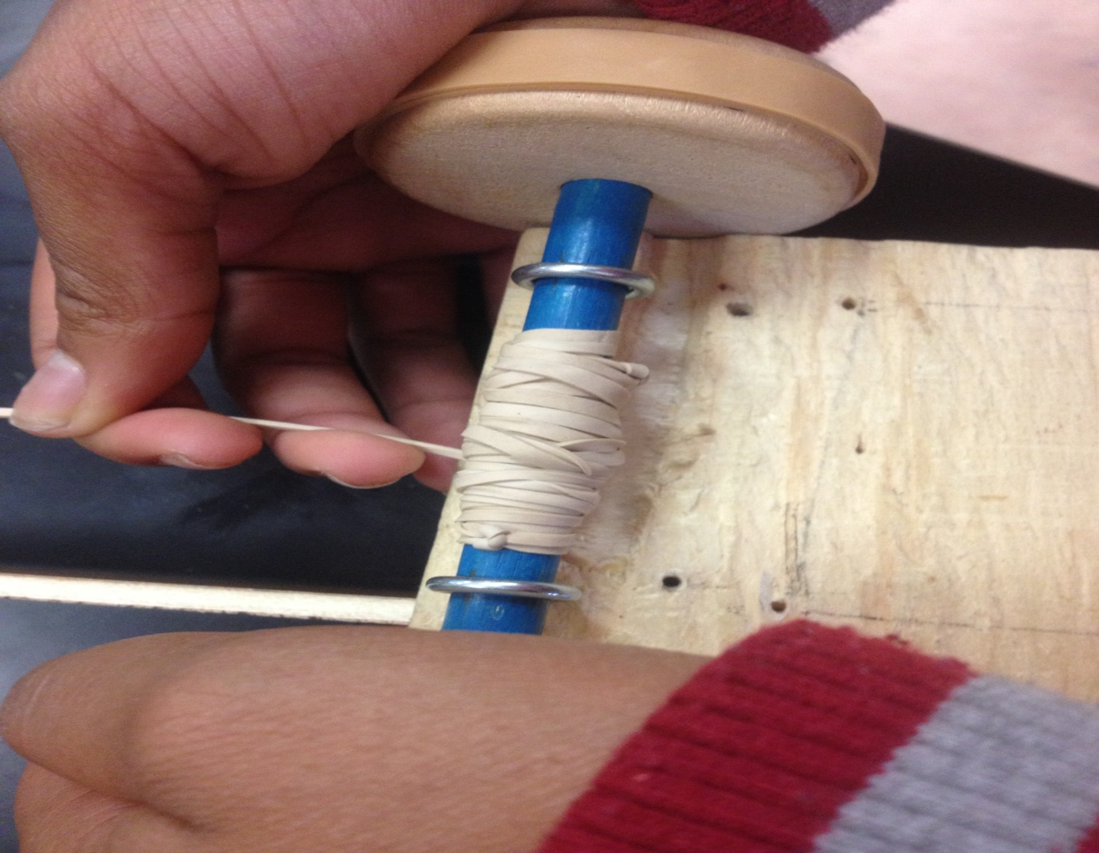
The Engine:

Slide 6
The Physics Behind It
The spring constant is 10.7
Our car has a maximum velocity of 1.1 m/s
The potential, kinetic, and thermal energy of the car changes over time.

Slide 7
Thanks For Your Consideration!

