Slide 1
Rube Goldberg Machine: The most complex way to put a penny in a piggy bank
Created By: Gabby Bitton, Nick bergo, Bryan Blair, Emilie baxter
With Great thanks to Mr. Williams!!!

Slide 2
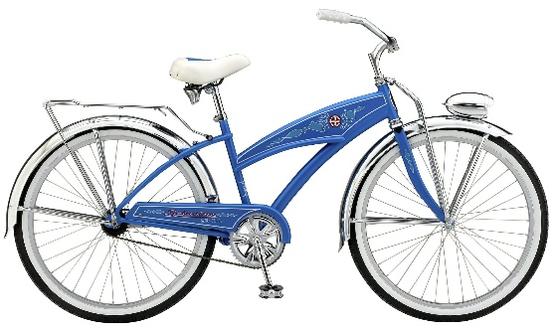
Wheel and axle hit cup of marbles
Kinetic Energy to Kinetic Energy:
Continuation of motion transferring energy from movement of objects
Example of wheel and axle

Slide 3
2. Marbles down screw
Find acceleration:
MA = distance of screw over distance of its height
Ag over Ma will equal the marble’s acceleration ( Ag = acceleration due to gravity)

Slide 4
3. Marbles hit jenga to release ball
Potential Energy to Kinetic Energy:
High position = pick up speed and momentum
Motion = energy to knock over book

Slide 5
4. Ball hits book to fall with lightweight
Mechanical Advantage:
Equals output force over input force
How hard or easy a machine makes an action
Pulley – circumference to lighten weight on each side

Slide 6
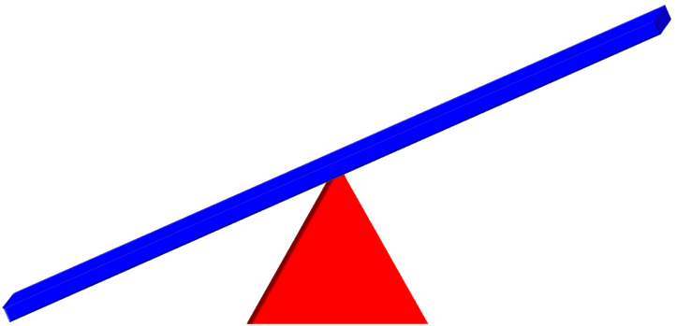
5. Heavy weight on other side drop on lever
Kinetic Energy to Potential Energy:
Force of weight on lever push stuck up high in position
Energy transfers to move up
Energy from previous motion
1st class lever- effort to fulcrum to load

Slide 7
6. Lever goes up to push marble down screw
Potential Energy:
PE = 1/2 x mass x acceleration due to gravity x height
Energy gained from position
Lever gives force to move stick up
- Gives momentum to go faster

Slide 8
7. Marble hits golf ball
Kinetic Energy:
KE = ½ x mass x velocity squared
Chain reaction
Kinetic to kinetic:
- energy transferred object to object
- allow to move
- considered as impulse and momentum

Slide 9
8. Golf ball hits yellow stick
Work and Force:
W = force x distance
F = mass x acceleration
Picks up speed from inclined plane
force of motion from potential energy
- power (P=W/T)
\\

Slide 10
9. Pulley – Wall-up
Mechanical Advantage:
MA = input distance over output distance
For pulley, MA=# of ropes that are not downward pull rope

Slide 11
10. Penny goes into piggy bank
Acceleration:
A = change in velocity over change in time
Freefall acceleration = 9.8 meters per second squared
Incline planed allows less time and more speed
- increase acceleration
- why ramps for snowboarders

